Slide 1


Spotify
Pandemic Music Shift
Exploring the Shift in Music Preferences Due to COVID-19.
www.spotify.com

Slide 2






Introduction and Research Questions
Research Problem
The COVID-19 pandemic altered music preferences, influencing genres, characteristics, and lyrics. Our research explores these changes during and after the pandemic.
Did the COVID-19 pandemic influence the popularity of music genres on platforms like Spotify?
What changes occurred in the musical characteristics of songs (e.g., energy, rhythm, modality) during and after the pandemic?
Did the emotional tone and lyrical content of popular songs change as a result of COVID-19?
Impact on Music Consumption
Changes in Musical Features
Shift in Lyrical Themes
1

Slide 3


















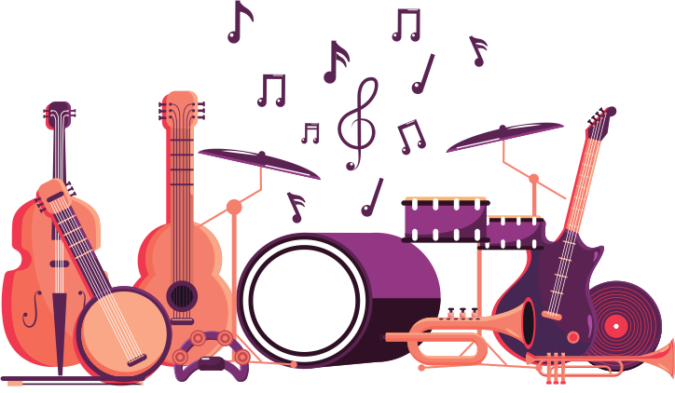










Data Features
Techniques Adopted
Why?
Artist Genre
Time Series
Track changes in music preferences over time.
Year
Track ID
Track Popularity
Track Name
Album
Playlist url
Group songs by audio features to reveal listener patterns.
Clustering
Artist Name
Artist ID
Artist Popularity
Danceability
Instrumental
Energy
Analyze lyrics to detect emotional themes & societal mood.
Loudness
Text Mining
Lyrics
Speechiness
Valence
acoustics
Liveness
Tempo
2

Slide 4

Data Exploration
Join datasets
summary statistics
visualizations
Join primary audio features dataset with a lyrics dataset for text mining
Data
Preprocessing
Data Cleaning
Correlation Analysis
Check missing values and duplicates
Remove irrelevant columns
Generate correlation matrix
Generate heatmap
Feature Categorization
Data Normalization
Classify variables into numerical and categorical
Visualize distributions: Bar Charts, Histograms
Min-Max scaling
3

Slide 5
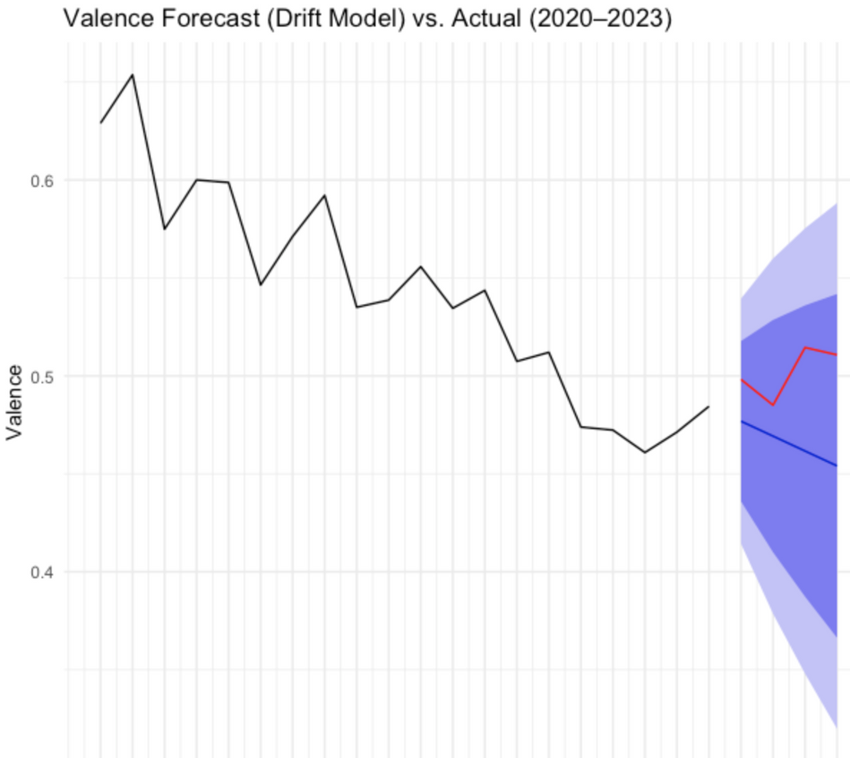
How COVID-19 changed the soundtrack of our lives?
Time Series Analysis
🎭 Valence (Mood)
Used yearly averages of musical features (2000–2023).
Autocorrelation Analysis: Compared pre- and post-COVID autocorrelation structures to detect stability/disruption in trends.
Drift Modeling: Built forecasts using 2000–2019 data to predict 2020–2023 trends.
Residual Analysis: Quantified deviation from expected values and tested for significance using Wilcoxon rank-sum tests.
Valence showed a clear divergence from its historical downward trend, with actual values during 2020–2023 exceeding forecasts. Residual analysis confirmed this shift was statistically significant (p = 0.0219), suggesting that popular music became more emotionally positive than expected—perhaps reflecting a collective cultural effort to process uncertainty and seek optimism in the wake of the pandemic.
4

Slide 6
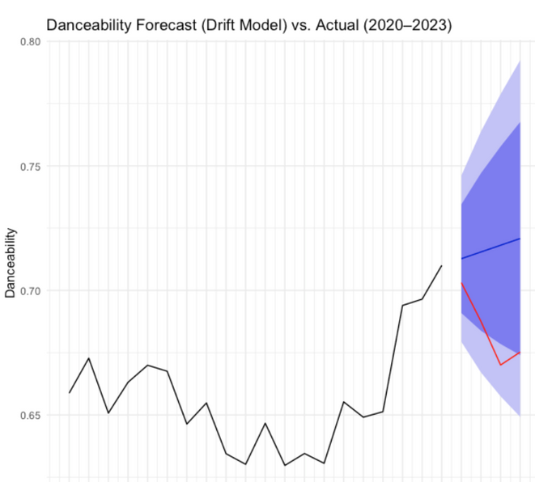
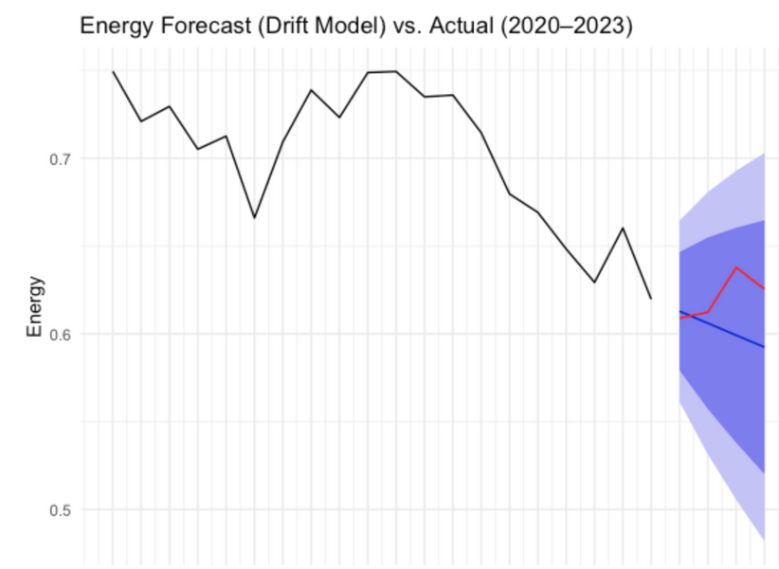
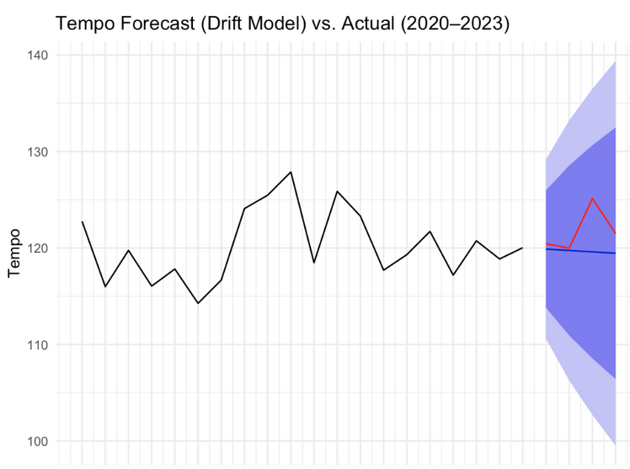
Time Series Analysis
Danceability: Actual post-COVID values consistently fell below the drift model’s forecast, indicating a significant break from the pre-pandemic upward trend. Residual analysis confirmed this difference was statistically significant (p = 0.0014), suggesting that rhythm- and movement-driven qualities in music remain disrupted.
Energy: While actual values in 2022 and 2023 slightly exceeded the drift model’s forecast, the deviation was not statistically significant (p = 0.09). This points to a possible but inconclusive rebound in musical energy following the pandemic.
Tempo: Post-COVID tempo values were modestly higher than predicted, but the difference was not statistically meaningful (p = 0.31). The results suggest tempo remained relatively stable, with only slight shifts that may reflect subtle stylistic adjustments rather than a structural break.
5

Slide 7
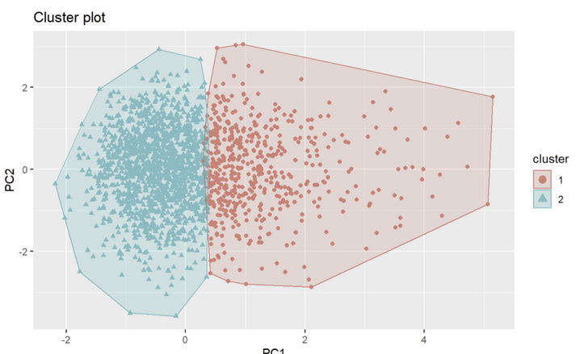
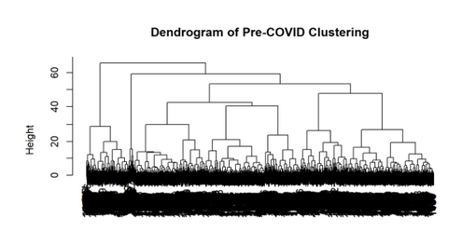

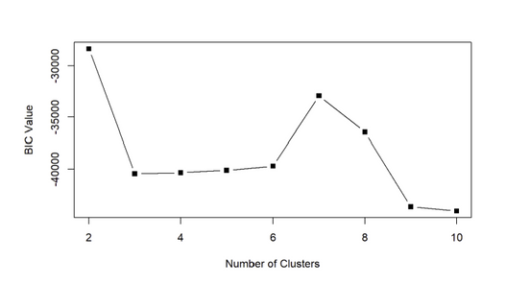
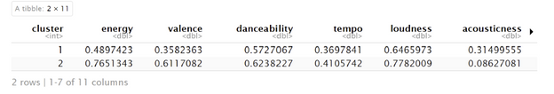
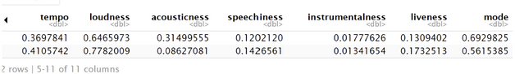
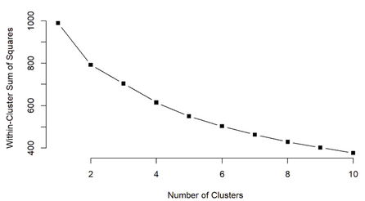
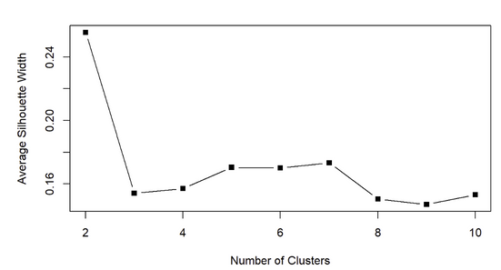
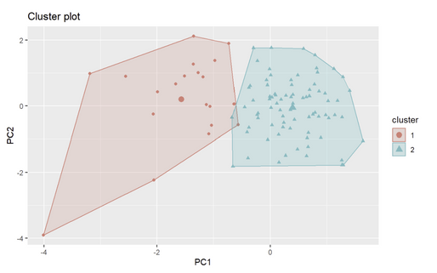
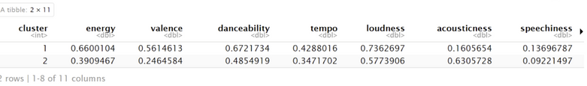
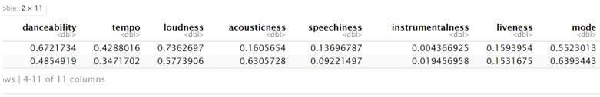
Clustering Analysis
Pre-pandemic
During pandemic
Post-pandemic
1
2
3
Pre-pandemic
During pandemic
Post-pandemic
Cluster 1: Calm, acoustic, slower tempo, low energy.
Cluster 2: Energetic, upbeat, faster tempo, loud.
Clear preference division between relaxing and high-energy music.
Cluster 1: Relaxing music, likely linked to emotional comfort.
Cluster 2: Energetic music, potentially related to virtual gatherings or exercise.
More diverse preferences influenced by emotional shifts.
Cluster 1: High energy, energetic music for emotional release.
Cluster 2: Calm, introspective, acoustic music.
Shift towards more emotional music, blending energetic and calming preferences.
6

Slide 8
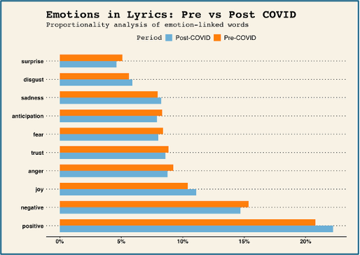
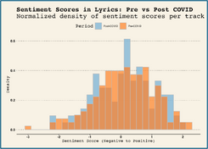
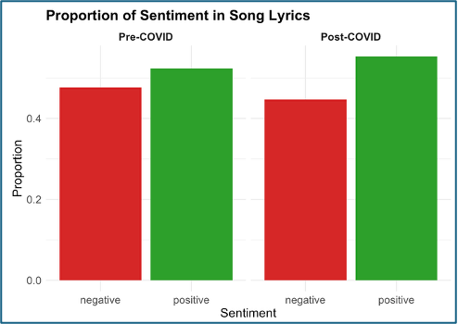
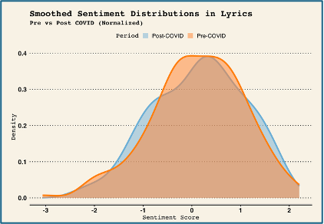
How did the thematic content of popular song lyrics change before and after the onset of COVID-19, and what does this reveal about cultural or emotional shifts in society?
Text Mining
Analysis using Emotion Lexicon
Analyze emotions using nrc emotion Lexicon
Sentiment Score Calculation
Sentiment Analysis
+ve and -ve sentiment analysis using Bing Lexicon
Calculating Sentiment score using afinn Lexicon
Pre-COVID had slightly more variability
Post-COVID lyrics tended to be more emotionally neutral to mildly positive, showing reduced variability in sentiment
This could reflect a societal shift towards more introspective, subdued, or universally relatable themes in music after the pandemic.
Negative sentiment decreased, & Positive sentiment increased from pre- to post-COVID.
This shows a shift toward more positive sentiment in song lyrics after COVID, which may reflect a cultural push for optimism.
Emotions like joy, trust, and anticipation increased post-COVID
Emotions, including negative, disgust, anger, fear, sadness, and surprise, all decreased
Song lyrics post-COVID exhibit a shift toward emotional positivity, possibly reflecting a broader cultural desire for resilience and optimism in the wake of the pandemic.
7

Slide 9
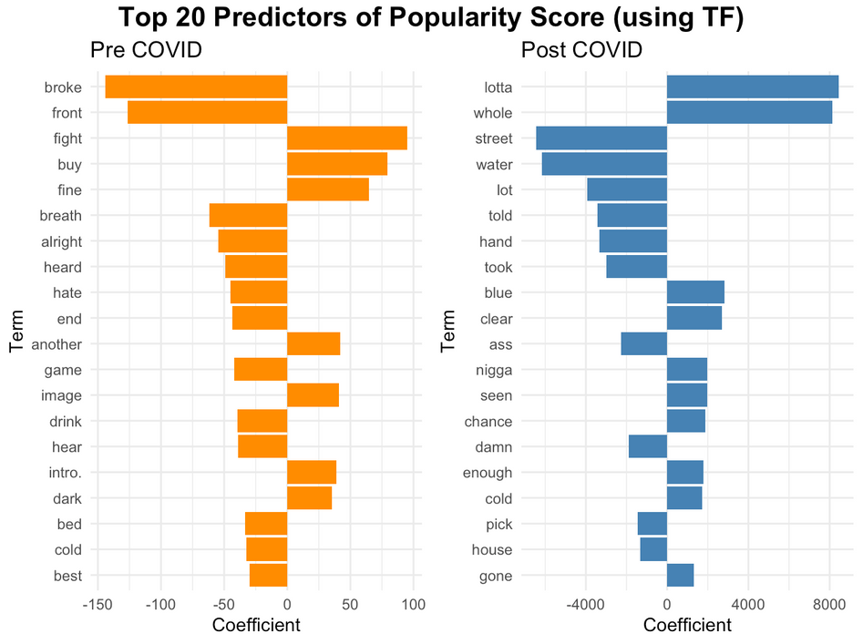
Did lyrical content influence song popularity differently before and after the pandemic?
Text Mining
Linear Regression Model to predict Popularity Score
Regression model using TF (bad of words approch) to predict popularity score
Preprocessing steps
Created text corpus from lyrics.
Applied cleaning steps to normalize and prepare data for text mining.
Convert to lowercase
Remove URLs and punctuation
Remove stopwords
Strip extra spaces
Perform stemming (reduce words to root form)
. Document-Term Matrix (DTM) Construction
Built DTMs:
Term Frequency (TF): Raw frequency of words
Removed sparse terms to reduce noise (retain frequent terms only).
Stem Completion- Used dictionaries to reconstruct readable terms from stems for interpretability in visualization.
Combine with Popularity Scores for modeling.
Pre-COVID: Negative themes (e.g., “broke,” “fight,” “hate”) reduced popularity; audience tastes were diffuse and hard to define.
Post-COVID: Expressive, relatable words (e.g., “lotta,” “street,” “mouth”) had strong positive impact.
Clearer preference emerged for emotional and grounded lyrics, with fewer negatively impactful terms.
8

Slide 10

Limitations
1.
2.
3.
4.
Lack of month-level granularity
Limited our ability to detect short-term shifts in music listening behavior, hindering detailed time series analysis.
Limited computational power
Text mining large volumes of lyrics was resource-intensive and time-consuming, slowing down the process.
Playlist Selection Bias
The dataset is based on Spotify’s Top 100 playlists, which reflect popularity but may be influenced by Spotify’s curation algorithms—introducing potential bias in which songs were included.
Small dataset
Restricted prediction accuracy, increased the risk of overfitting, and reduced statistical power.
9

Slide 11
Conclusion
Recommendations
For Streaming Platforms: Curate mood-based playlists aligned with evolving emotional states (e.g., “soothing & reflective” vs. “reclaiming joy”)
COVID-19 disrupted music’s emotional and rhythmic patterns: Time series analysis revealed a sharp break in trends—valence rebounded (↑ joy, p = 0.0219) while danceability declined and remained low (p = 0.0014), suggesting lasting shifts in listener mood and movement.
Listeners split between introspection and celebration: Clustering showed two enduring emotional “tracks”—one calm and acoustic, one energetic and upbeat. Their separation narrowed during the pandemic, then widened again post-COVID.
Lyrics became more emotionally authentic: Sentiment analysis showed a rise in words tied to healing (trust, hope, joy), and post-pandemic lyrics became simpler, more emotionally grounded, and more popular when they expressed relatable resilience.
For Analysts & Product Teams: Track long-term shifts in lyrical sentiment and acoustic features to better anticipate changes in user taste.
For Artists & Producers: Emphasize emotional honesty and acoustic textures to align with listeners’ deeper post-pandemic values.
For AI & Recommender Systems: Integrate time-sensitive emotional modeling to adapt to large-scale social or cultural disruptions.
The COVID-19 pandemic reshaped music’s emotional and rhythmic landscape, revealing lasting shifts in how people seek connection, comfort, and meaning through sound.
10

Slide 12
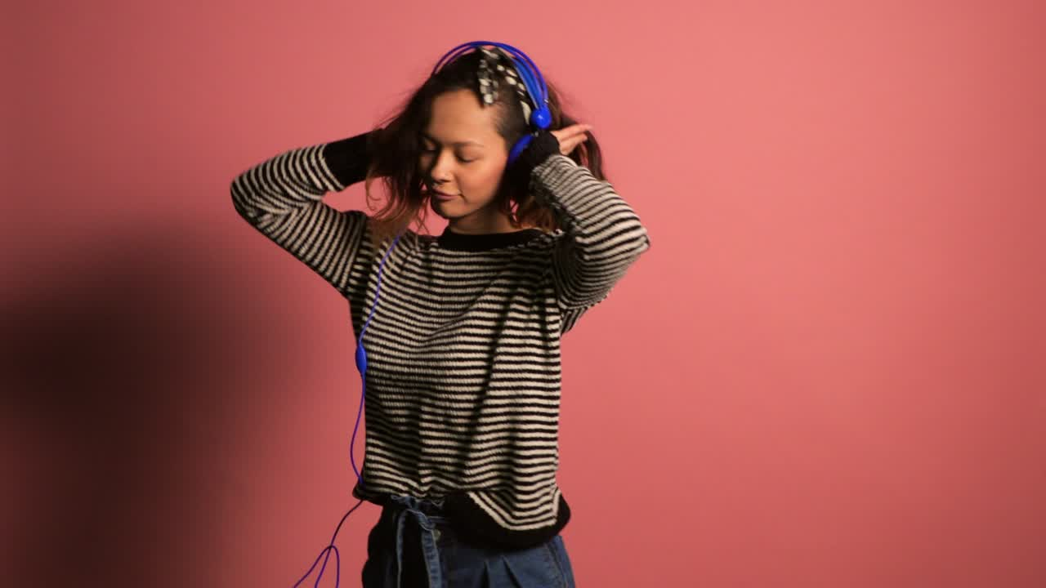
THANK YOU
for your time and attention

